Slide 1
Overview of SOA Services, Integration and Microservices
Oxford University
Software Engineering Programme
June 2016

Slide 2
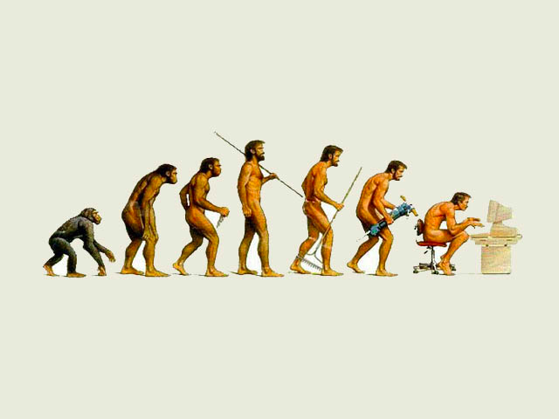

Slide 3
Distributed Computing

Slide 4
Why is Distributed Computing important?
Scale
Evolution
Integration
Cross-boundary
Resilience

Slide 5
Some History

Slide 6
DCE Distributed Computing Environment
Standardized remote procedure call model proposed in the 90s by the Open Software Foundation (OSF)
Didn’t succeed widely, except as part of Microsoft’s DCOM

Slide 7
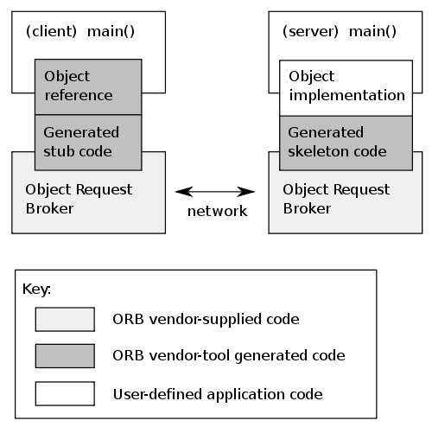
CORBA Common Object Request Broker Architecture
An attempt to move DCE like distributed computing into the OO world
Object Management Group (OMG)
Still in some use today
Stagnated/Deprecated

Slide 8
SOAP Simple Object Access Protocol
XML approach to replace CORBA/DCE, etc
Theoretically built to be transport independent and message oriented
97% of the time used over HTTP in RPC model
We will cover in much more detail later

Slide 9
REST
Representational State Transfer
A model that influenced and was based on HTTP 1.1
Web approach to distributed computing and integration
We will cover in much more detail later

Slide 10
Next generation RPC (Remote Procedure Call)
Java RMI (Remote Method Invocation)
Google Protocol Buffers
Apache Thrift
Apache Avro
Kryo etc
Twitter’s Finagle

Slide 12
Integration
It is unhelpful to consider Distributed Computing and SOA without considering Integration
Integration is the problem of creating applications that incorporate existing as well as new logic
Almost no system is standalone and does not need to evolve!
Even embedded systems are now moving to incorporate Internet and Messaging

Slide 13
Integration points
Data
Integration in the database layer
Application
Inter-application integration
Web tier
Portal based integration
On-the-glass
Cut and paste

Slide 14
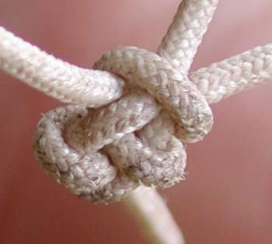
Tightly coupled
Tightly coupled systems have significant problems:
Errors, delays and downtime spread through the system
The resilience of the whole system is based on the weakest part
Cost of upgrading or migrating spreads
Hard to evaluate the useful parts from the dead weight

Slide 15
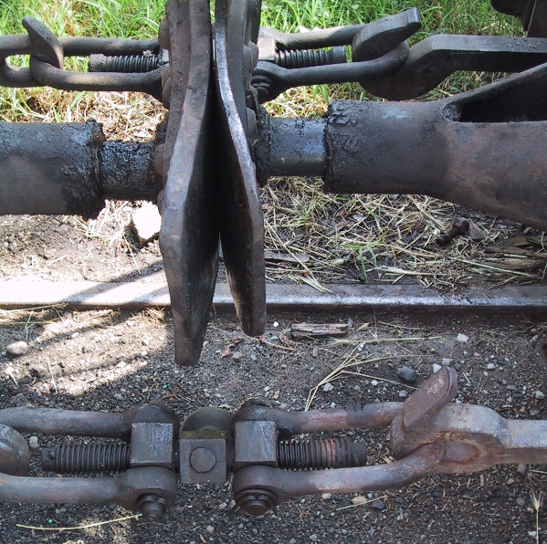
Loose coupling

Slide 16
“6 Degrees of Separation”
Location
Access
Programming Language
Stack/Vendor
Time
Scalability
Notes:
X.901 defines: access, location, migration, replication, concurrency, scalability, performance, failure

Slide 17
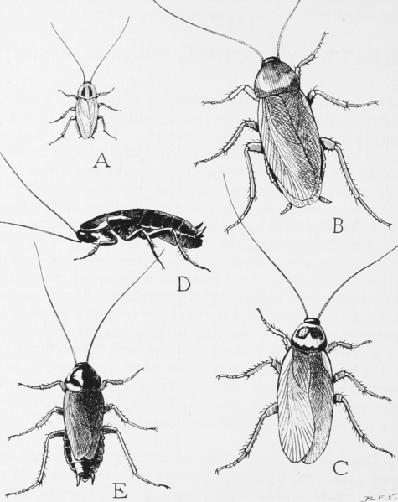
Batch file transfer - the cockroach of integration

Slide 18
File transfer lives on
Existing System
Existing System
XML/JMS
legacy
flat file
WSO2 ESB
Split/Iterate
DBLookup/Filter
Transform to MQ
Send
Database
WSO2 ESB
Poll
Record->XML
XML->XML
Send
NEW YORK
LONDON

Slide 19
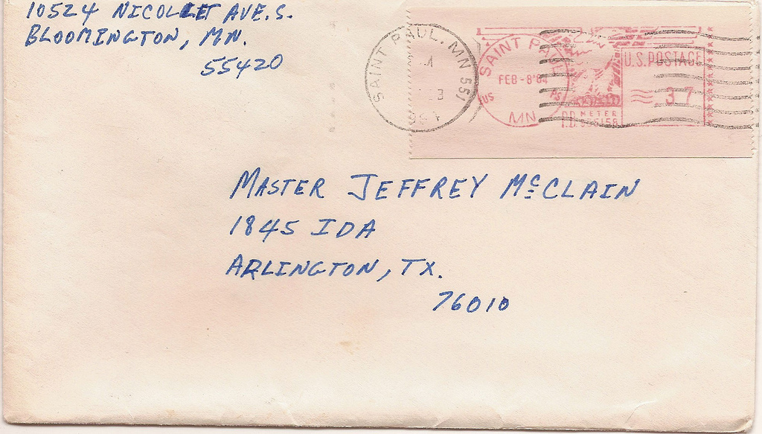
“Message Oriented Middleware”
http://www.flickr.com/photos/robeast/

Slide 20
MOM model
Decouple message producers from consumers
Decoupled in addressing and in time
Not inherently decoupled in message format
Though in many cases that too
One-way asynchronous messages
But request-reply possible using “Reply Queues”
Usually used with reliable delivery

Slide 21
Event Driven Architecture
Event Consumer
Event Producer
Event
Event Consumer

Slide 22
“Event Driven Architecture”
Actually how Apache (and WSO2) work(s)
Mailing lists = topics
Can be layered with reliable delivery
Used a lot in high-volume logging, trading environments, fraud detection, etc
Requires a very different mindset

Slide 23
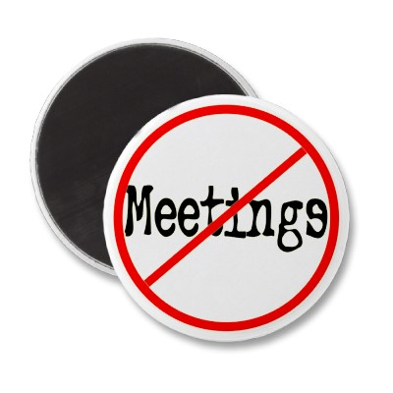
EDA

Slide 24
Why did SOA evolve?
Directly came out of XML
Understanding the schema and structure of messages
Especially within the “fabric” not just at the endpoints
What’s different?
Metadata
Policies
Security

Slide 25

Service
http://www.flickr.com/photos/yjv/

Slide 26
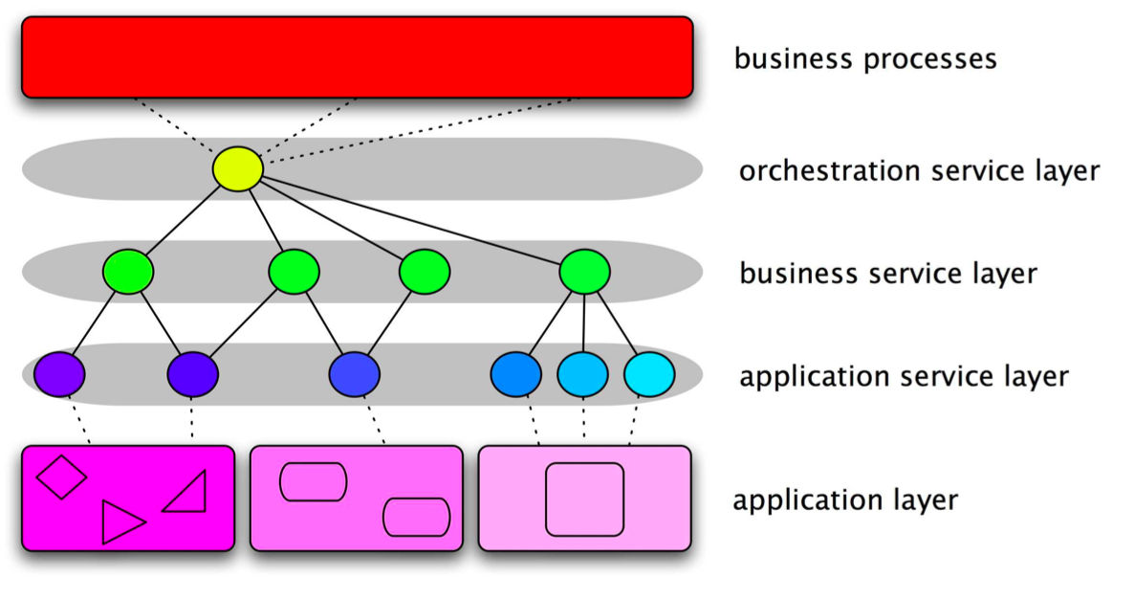
SOA

Slide 27

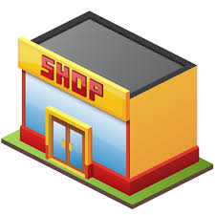
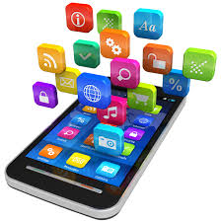



End-to-End Architecture and Functional Requirements for a Connected Business
Develop
Publish
Consume and Run
Secure
Monitor and
Manage
Systems
Of Engmnt
Web App
Development
Public / Private
App Store
Mobile Apps
Web Apps
Portal
SSO
Device Management
Web Access Mgt
API
SDKs
API Store
API Gateway
API Analytics
MBaaS
OAuth2
Service Tooling
Governance Registry
Enterprise API Gateway
Service
Access Control
Business
Analytics Monitor
SOA
Orchestration
Workflow
RT Stream Proc
ESB
Data
Virt
Taxonomy
Ontology
Data Tooling
Data Registry and Governance
Data Services
Data Access Control
Data Analytics
Big Data
Enterprise Cache
Adapter Layer
System
Of Record
Legacy Tooling
Traditional Documentation
SAP
MF
P’Soft
Legacy
Directory
Enterprise
Monitoring
Oracle
CICS
IBM
CRM

Slide 28
Web Services != SOA
There are SOA’s that don’t use Web Services
We will see some in the case studies…
There are systems that use Web Services that are not Service Oriented
e.g. Taking an existing text/TCP model and tunnelling over SOAP

Slide 29
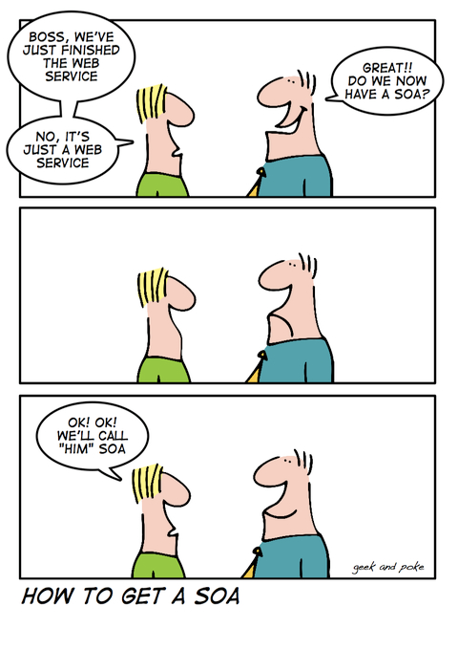

Slide 30
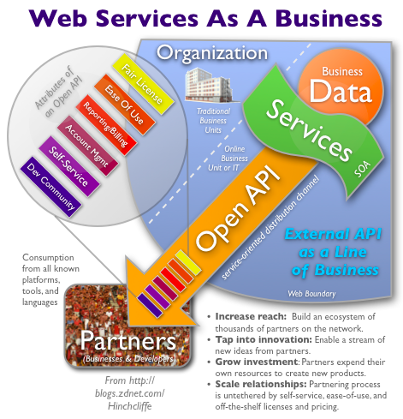
Running your SOA like a Web startup
http://www.zdnet.com/blog/hinchcliffe/running-your-soa-like-a-web-startup/525

Slide 31
APIs
An API is a business capability delivered over the Internet to internal or external consumers
Network accessible function
Available using standard web protocols
With well-defined interfaces
Designed for access by third-parties

Slide 32
What is different from an API and a Service?
Publishing your API in a Portal
Expecting people to use it without them having to meet with you
Making it easy to consume (JSON? Ready built clients in Github?)
Governance
Caring who uses it
Letting them know when you version it
Meeting an SLA

Slide 33
Microservices Characteristics (Martin Fowler)
Componentization
Replacability
Organisation
around business capabilities instead of around technology.
Smart endpoints and dumb pipes
explicitly avoiding the use of an Enterprise Service Bus (ESB)
Decentralised data management
with one database for each service instead of one database for a whole company.
Infrastructure automation
with continuous delivery being mandatory.
http://martinfowler.com/articles/microservices.html

Slide 34
Micro and Macro Services
API Facade
API Facade
API Facade

Slide 35
Change in focus
Security, tokens, access control/entitlement
API Management
Microservices
Throttling, caching
Latency and CPU usage
Monitoring, metering and predictive analytics

Slide 36
?

